Slide 1

Container Crisis 3: More Containers More Problems
By: Caprico (Nate Johnson)

Slide 2

~# Whoami
Offensive Security Technical Lead – at QOMPLX
Podcast Contributor to the:
IronGeekCast
GrumpyHackers
HackThePlanet (guest)
Darknet Diaries (researcher)

Slide 3
Index.php
RTFM containers
Possible uses for Penetration Testing
HACK THE PLANET!!! (Container Edition)
Hack the botnet?
State of Crypto-Jacking Botnets (2022) RTFM = Read the Fine Manual

Slide 4
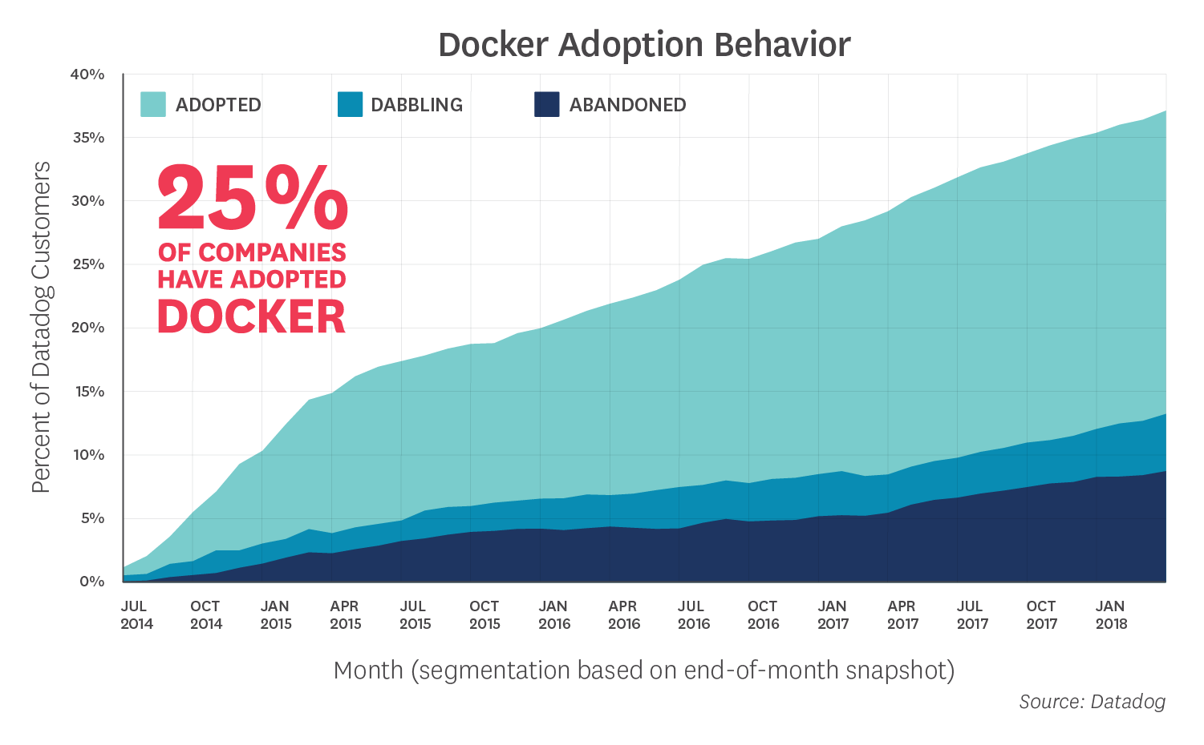
Why do we need to Care?
As of 2018 25 % of companies have adopted docker
This includes:
Production
Development
Enterprise
Source: https://www.datadoghq.com/docker-adoption/

Slide 5
Why do we need to Care?
This number has only gone up in the past four years
Source: https://www.datadoghq.com/docker-adoption/

Slide 6
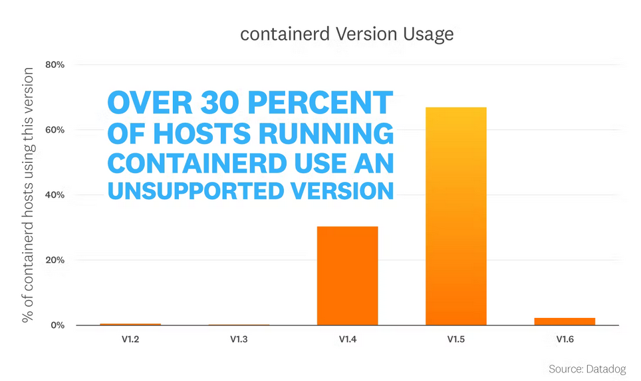
Why do we need to Care?
2022 - 30% of hosts are running an unsupported containerd version
Source: https://www.datadoghq.com/container-report

Slide 7
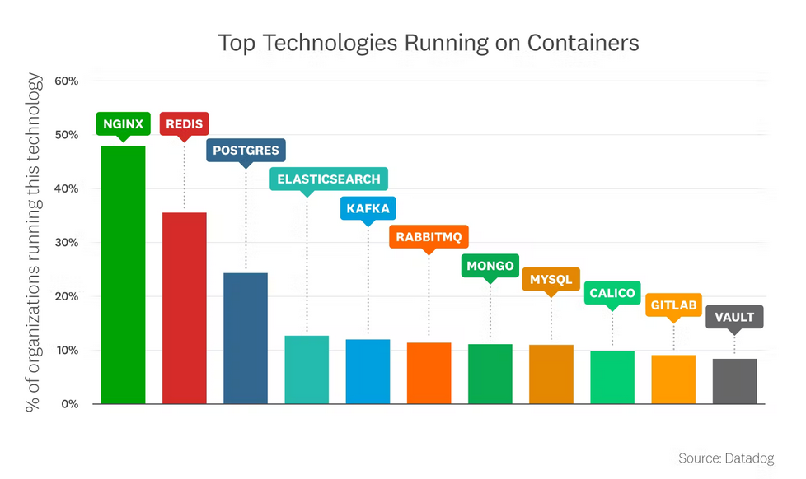
Why do we need to Care?
2022 – Probably some sensitive stuff in those OUT-OF-DATE CONTAINERD VERSIONS.
Source: https://www.datadoghq.com/container-report

Slide 8
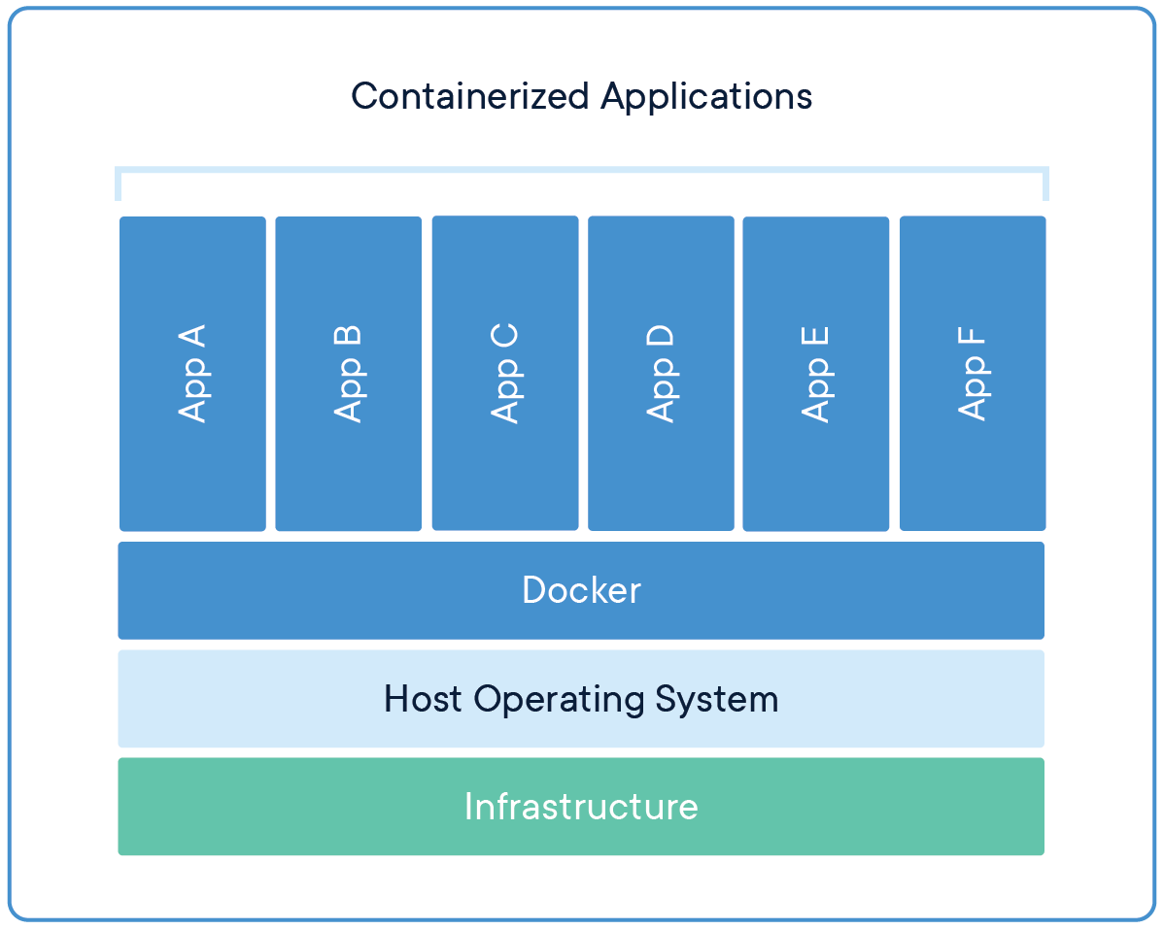
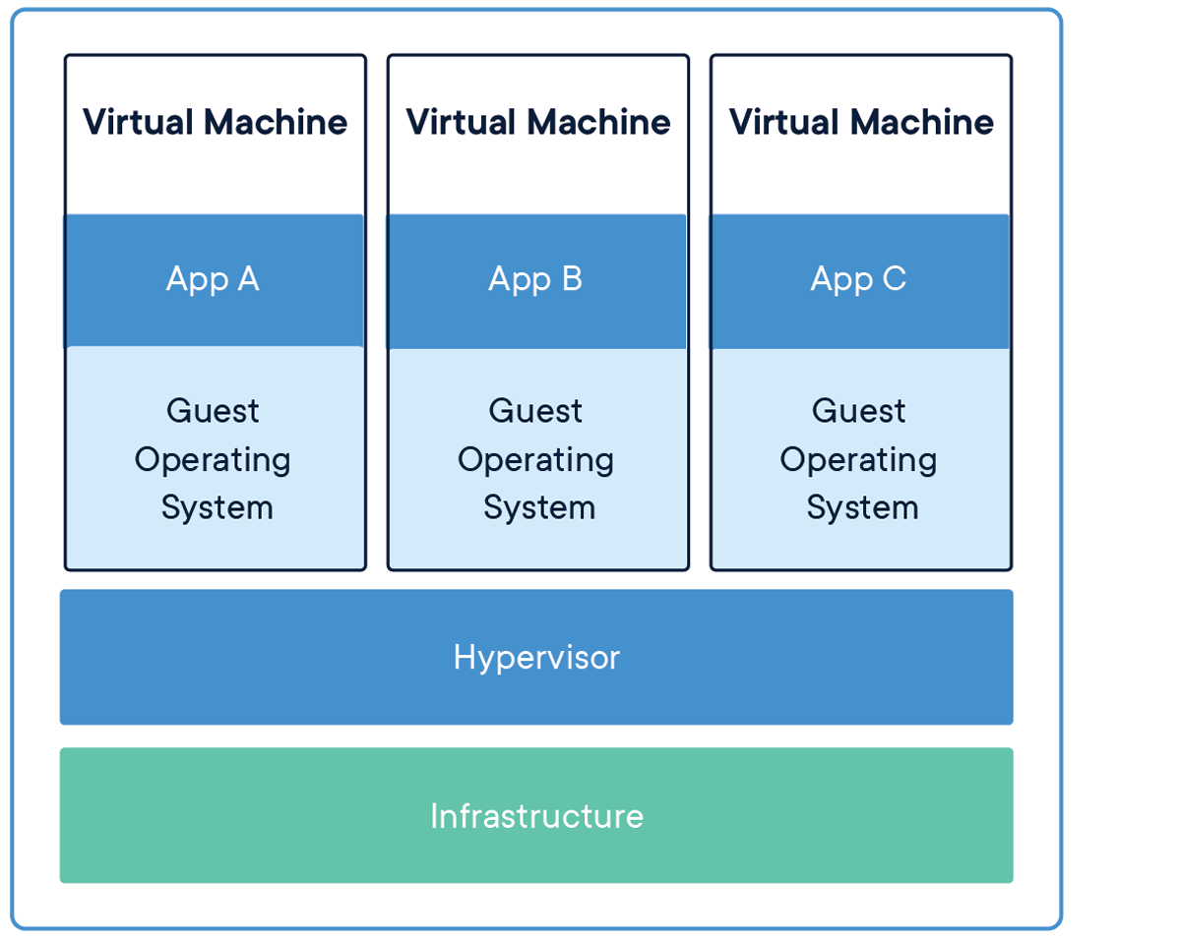
RTFM Containers
So what is a Container?
It’s like a Virtual Machine but it isn’t…
Source: Docker.com

Slide 9

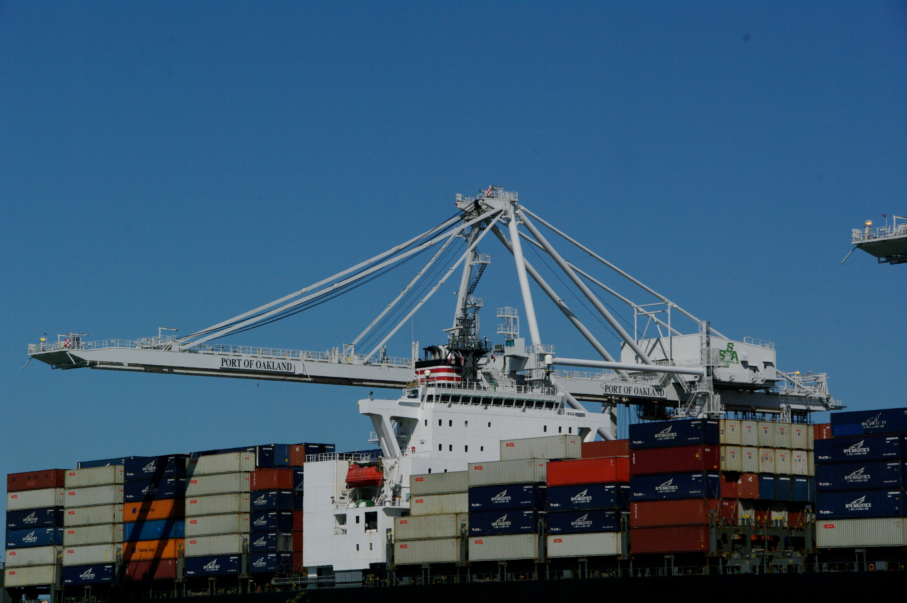
RTFM Containers
So what is a Container?
It’s like a Virtual Machine but it isn’t…
Source: morguefile.com

Slide 10
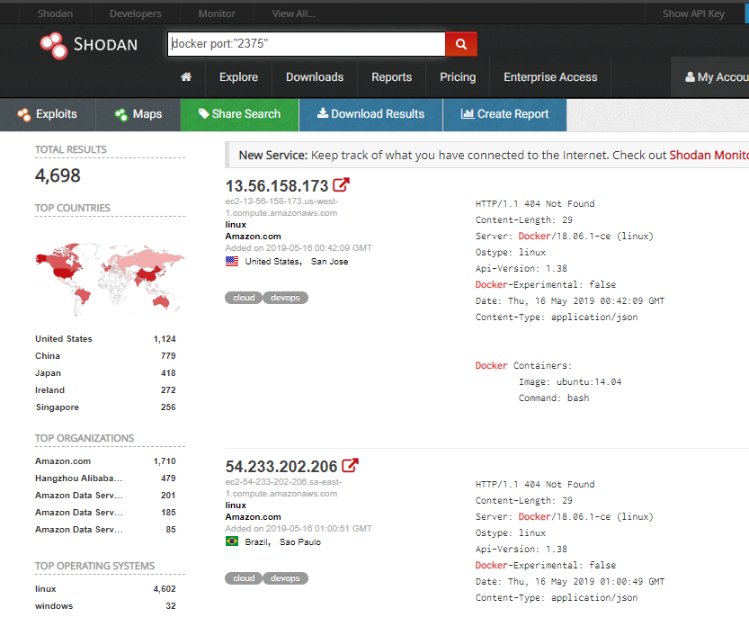
RTFM Containers
Where is it used?
Production Services
Developers
We’ll come back to this pic…
Source: https://www.shodan.io/search?query=docker+port%3A2375

Slide 11
Penetration Testing Uses
Docker is great at running tools.
Dependencies handled
Segmented networking for reverse engineering
Development of tools for cross OS testing
Etc.
Notes:
Dependencies can be handled quickly using docker containers and images.

Slide 12
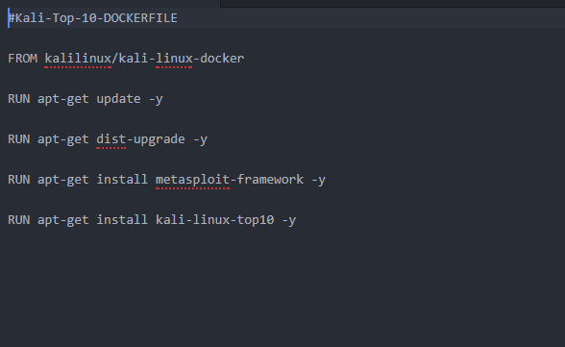
Penetration Testing Uses
Example: My First Project
Replace my bloated KALI VM (60 gbs)
So I made a docker image

Slide 13
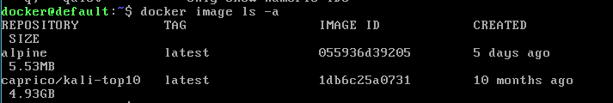
Penetration Testing Uses
My First Project
Replace my bloated KALI VM (60 gbs)
So I made a docker image
For reference it’s 5 gigs now…with MSF

Slide 14
Penetration Testing Uses
Possibilities are really endless with docker.
Pick a tool/attack
Build image(s) to fulfill attack needs
Phishing
GoPhish
C2s
Empire, Covenant, etc.
Etc.

Slide 15
HACK THE PLANET!!! (container edition)
Let’s talk about how to hack into containers
Getting onto the container
Check your privilege(s)
Persist

Slide 16
Getting onto the container
Hacking methodology (recon, exploit, persist)
Web app fails (LFI, RFI, Shell upload, XSS, etc.)
Docker Socket
Common ports: tcp/2375 and tcp/2376
HacktheBox has these for privesc

Slide 17
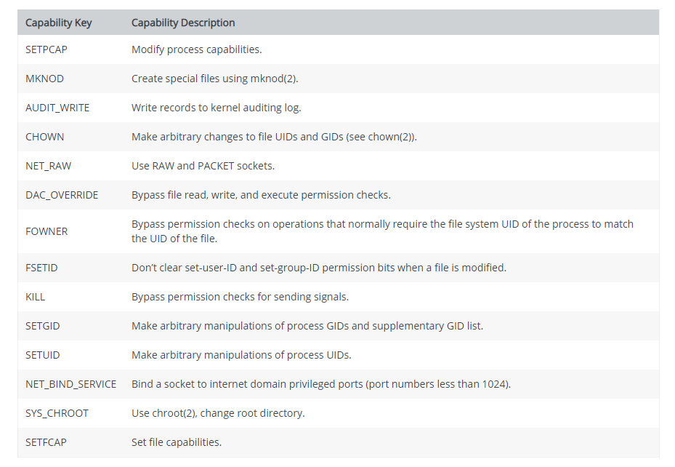
Check your privilege(s)
Docker has Many privileges that containers can have by default.
Source: docs.docker.com

Slide 18
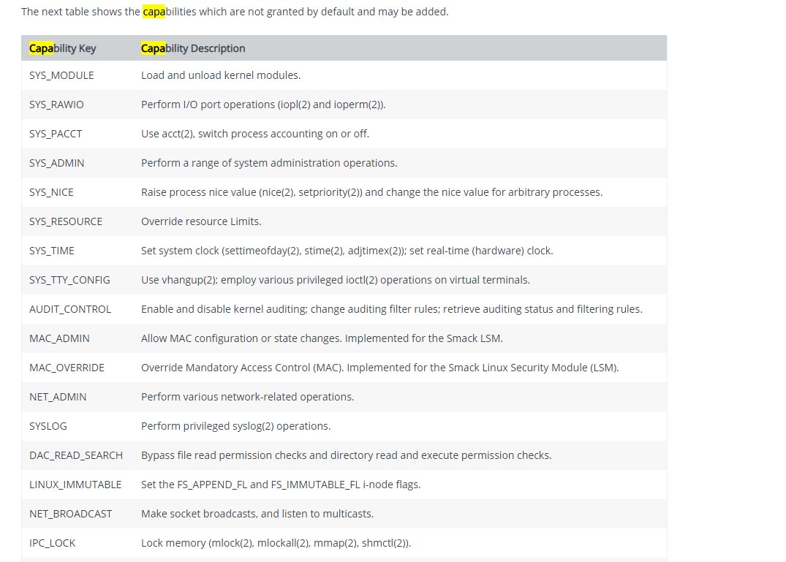
Check your privilege(s)
NEVER DO THESE!
--privileged
--cap-add-all
Source: docs.docker.com
Notes:
I don’t think you want to have anyone to have system administration or net admin capabilities. OH AND SYSLOG!!!

Slide 19
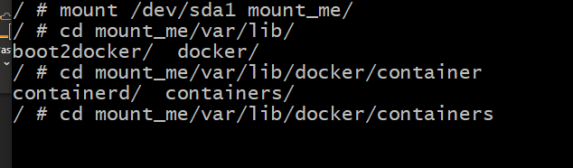

Slide 20
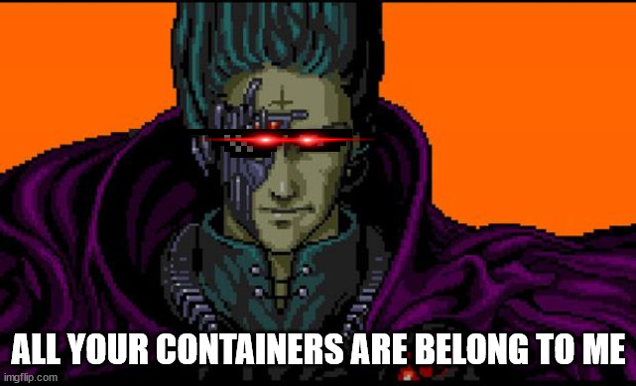
Well…that’s cool.

Slide 21
Hack the botnet…
“A way that docker can be exploited will be in the creation botnets. Where we will see docker containers or shadow containers being created to make these large clusters for attackers to use to attack internal systems.” - Me July, 2018 for Bachelors Capstone Project

Slide 22
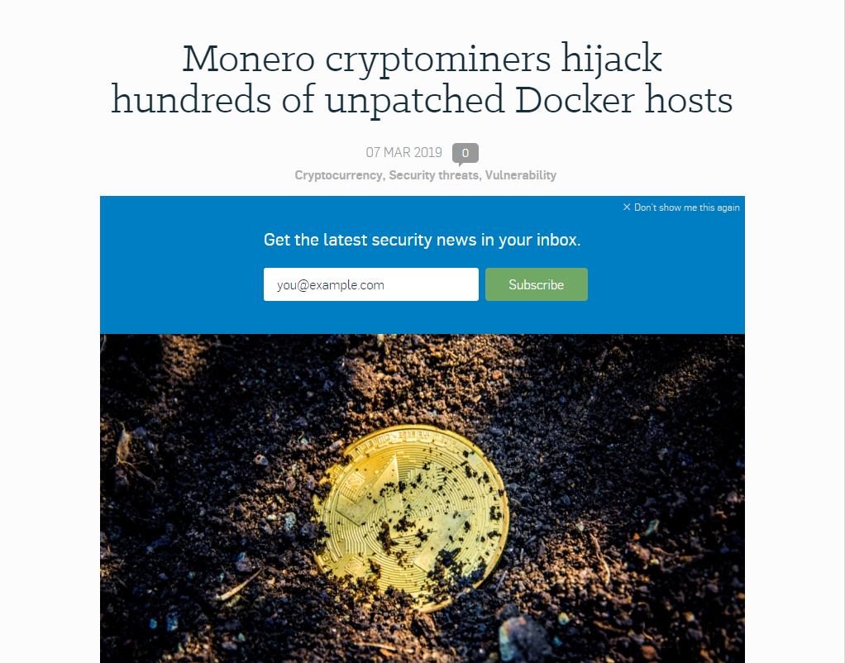
Hack the botnet…
Monero Botnet installing containers with crypto mining images via docker socket.
Source: https://nakedsecurity.sophos.com/2019/03/07/monero-cryptominers-hijack-hundreds-of-unpatched-docker-hosts/

Slide 23
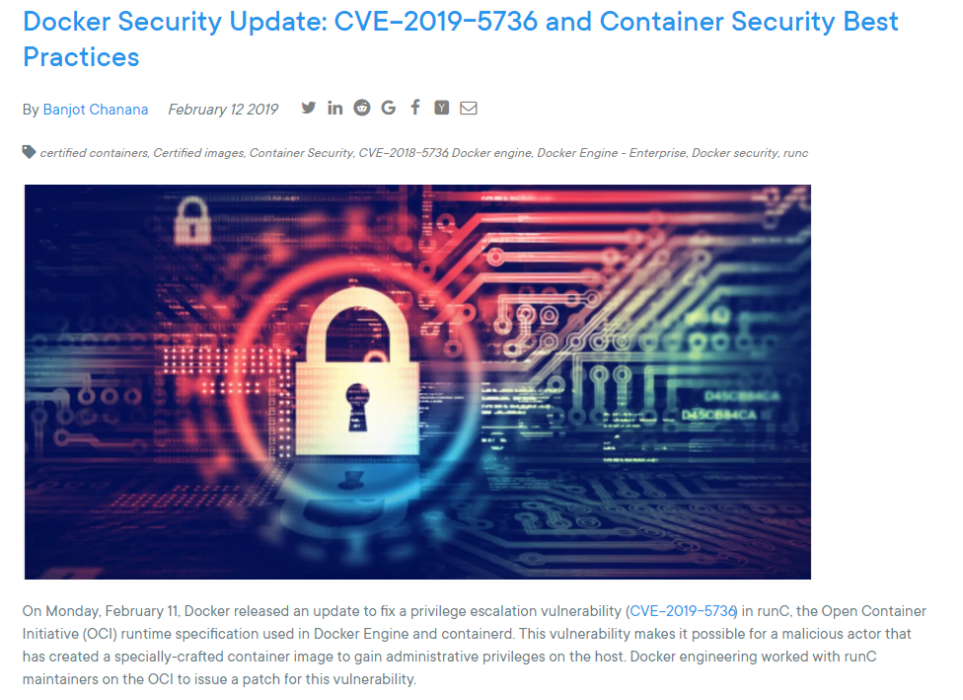
Hack the botnet…
Specially crafted containers to escalate privileges into containerd
Source: https://blog.docker.com/2019/02/docker-security-update-cve-2018-5736-and-container-security-best-practices/

Slide 24
Hack the botnet…
Docker Socket fails
EX: `# docker run –H <host>:<socket port> alpine`
https://www.youtube.com/watch?v=ib4lx9i6DLA&list=FLU7PgmLMYcRexHCU7rmnxmw&index=4&t=0s

Slide 25
Hack the botnet…
Now one night I look at shodan and find this.

Slide 26
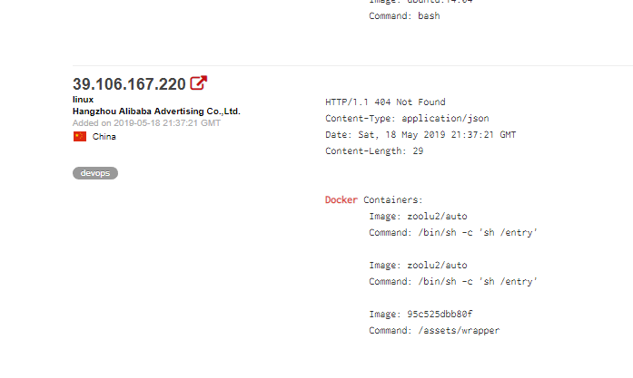
Hack the botnet…
Now one night I look at shodan and find this.

Slide 27
Hack the botnet…
So I google for this username…

Slide 28
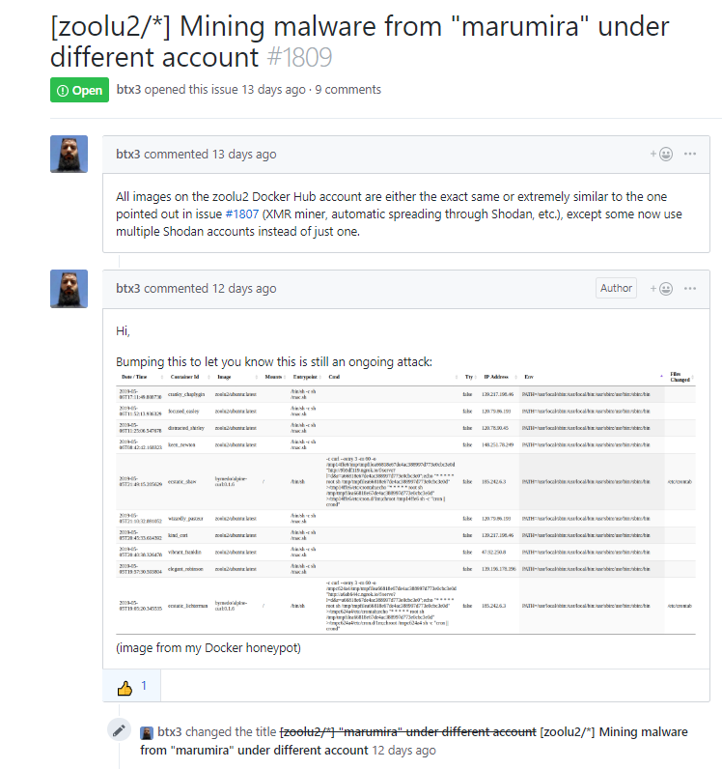
Hack the botnet…
Someone also had been getting some fishy containers in his honeypot
Notes:
This guy has a honeypot with port 2375 misconfigured.

Slide 29
Hack the botnet…
We talked in the issue and found the attack was still ongoing.
Time to hack a hacker (kinda).
Notes:
This guy has a honeypot with port 2375 misconfigured.

Slide 30
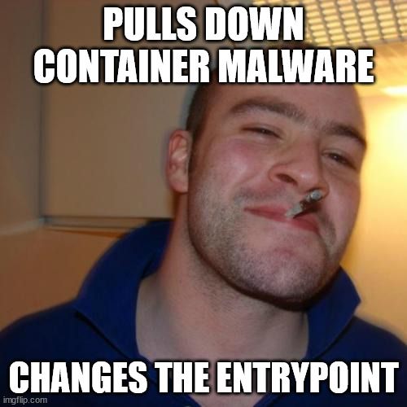
Time to inspect the image
I pulled down the image that was hosted on docker hub and….
Demo time.

Slide 31
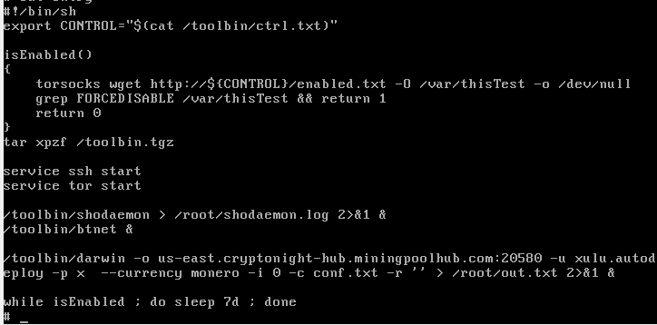
Hack the botnet…
`docker inspect zoolu2/auto`
`docker run –it –entrypoint “/bin/sh”zoolu2/auto`
`cat /entry
Notes:
This guy has a honeypot with port 2375 misconfigured.

Slide 32
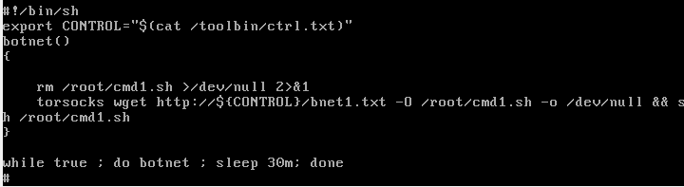
Hack the botnet…
Notes:
This guy has a honeypot with port 2375 misconfigured.

Slide 33
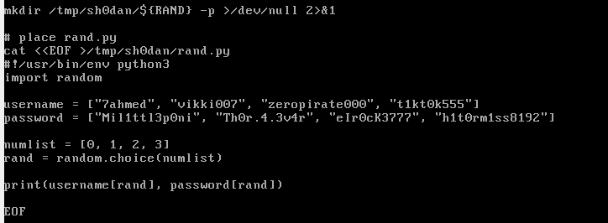
Hack the botnet…
Notes:
This guy has a honeypot with port 2375 misconfigured.

Slide 34
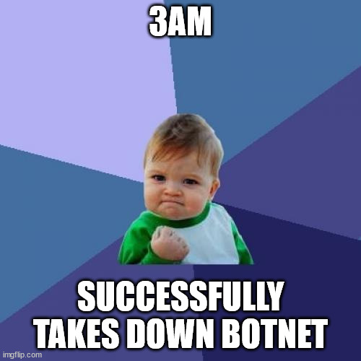
Hack the botnet…
Contacted Shodan and Docker and all accounts were banned…
Notes:
This guy has a honeypot with port 2375 misconfigured.

Slide 35
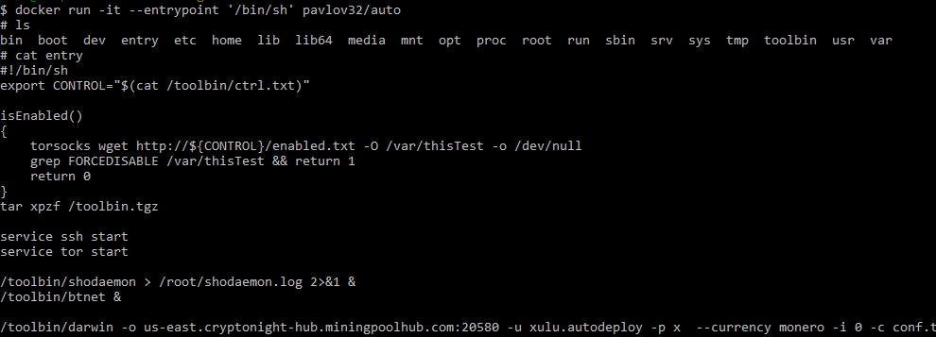
Hack the botnet…
Okay….so he showed up again…
Notes:
This guy has a honeypot with port 2375 misconfigured.

Slide 36
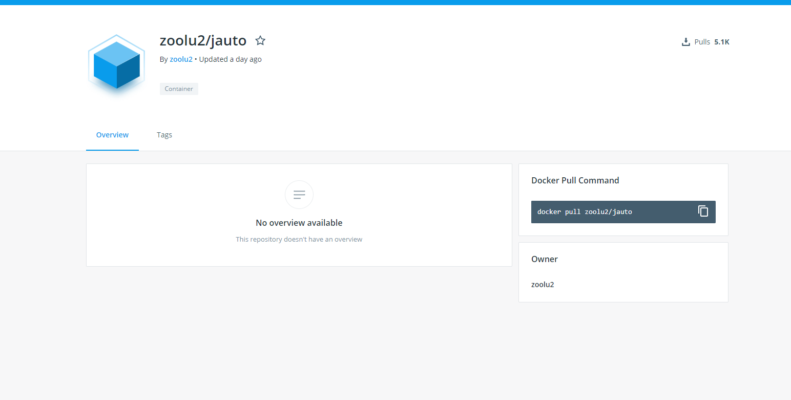
Hack the botnet…
And again…
Notes:
This guy has a honeypot with port 2375 misconfigured.

Slide 37
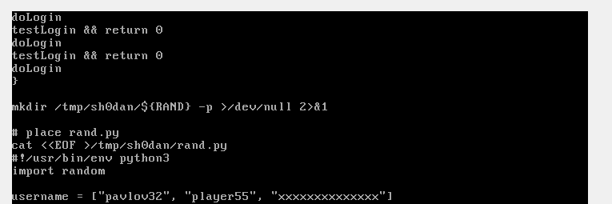
Hack the botnet…
And this time he used the last username…
Notes:
This guy has a honeypot with port 2375 misconfigured.

Slide 38
Hack the botnet…
And again…
Notes:
This guy has a honeypot with port 2375 misconfigured.

Slide 39
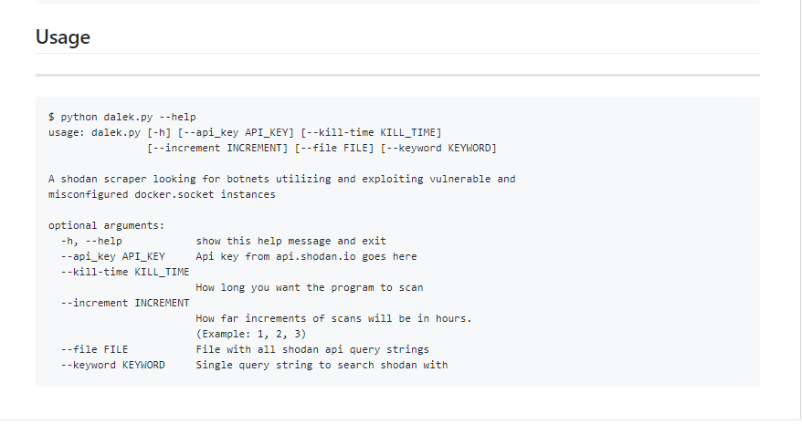
Tool To Find/Track The bots
Dalek https://github.com/Caprico1/Dalek

Slide 40
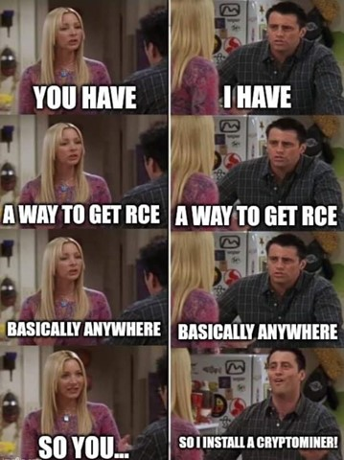
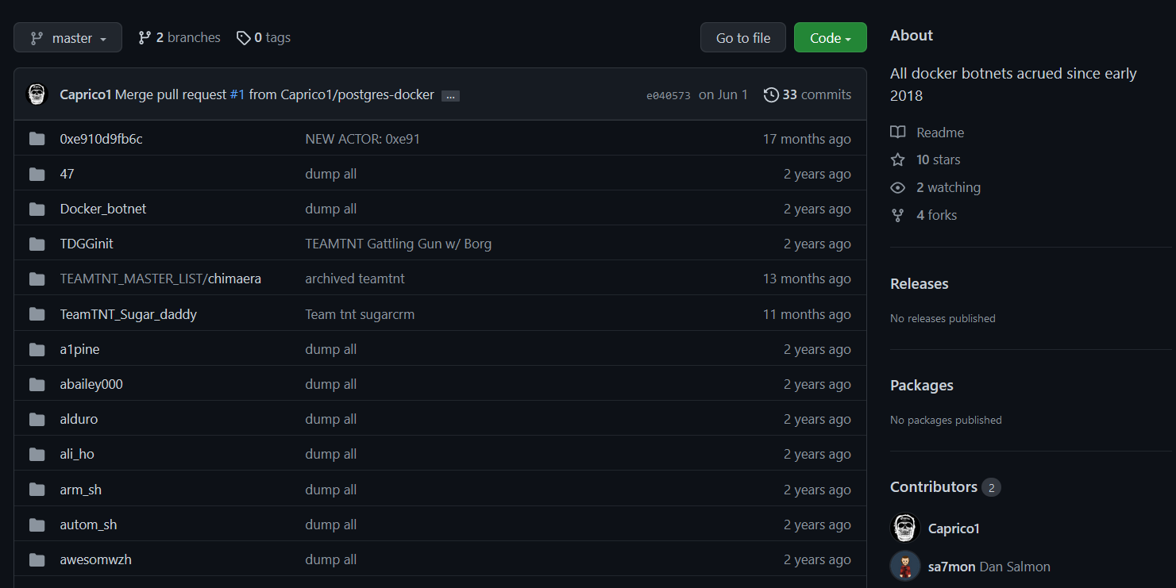
State of Crypto-Jacking Botnets (2022)
It’s gone beyond just a docker issue

Slide 41
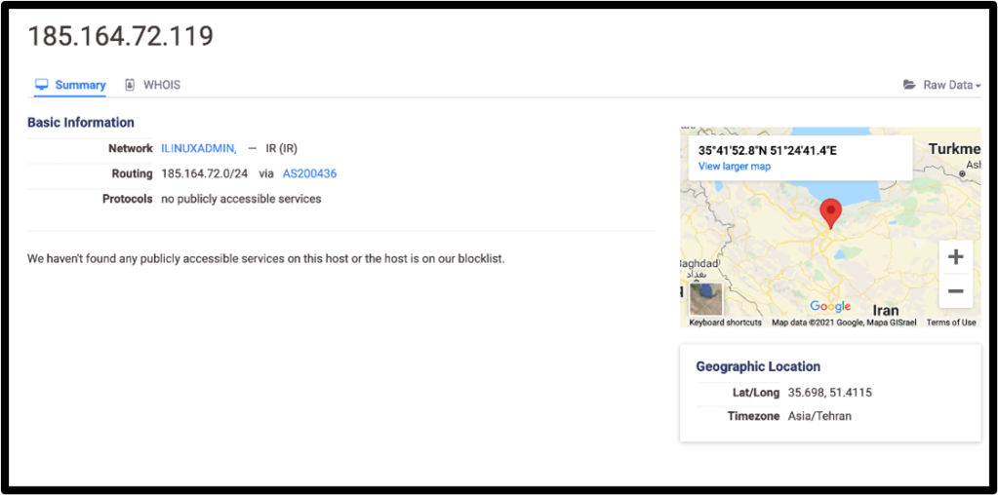
State of Crypto-Jacking Botnets (State-Sponsored?)
Notes:
APT’s using this.

Slide 42
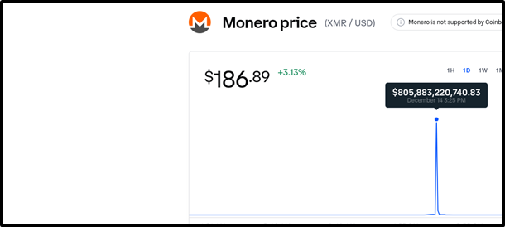
State of Crypto-Jacking Botnets
Log4j crypto-jacking campaigns caused a massive spike in Monero
Notes:
Log4j exploit spike.

Slide 43
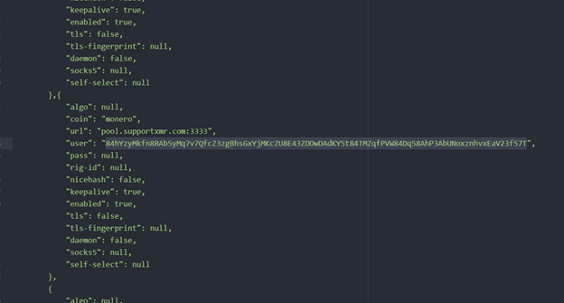
State of Crypto-Jacking Botnets
Conti Leaks
Notes:
Log4j exploit spike.

Slide 44
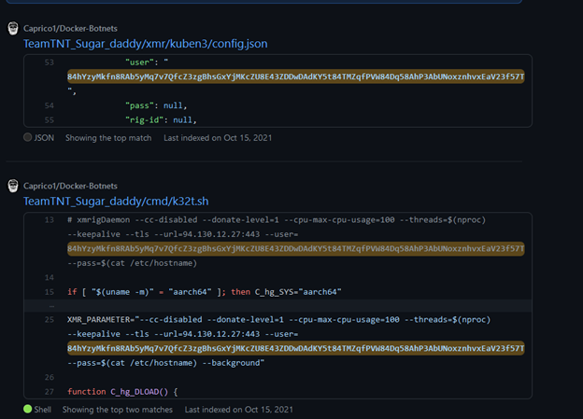
State of Crypto-Jacking Botnets
Notes:
Log4j exploit spike.

Slide 45
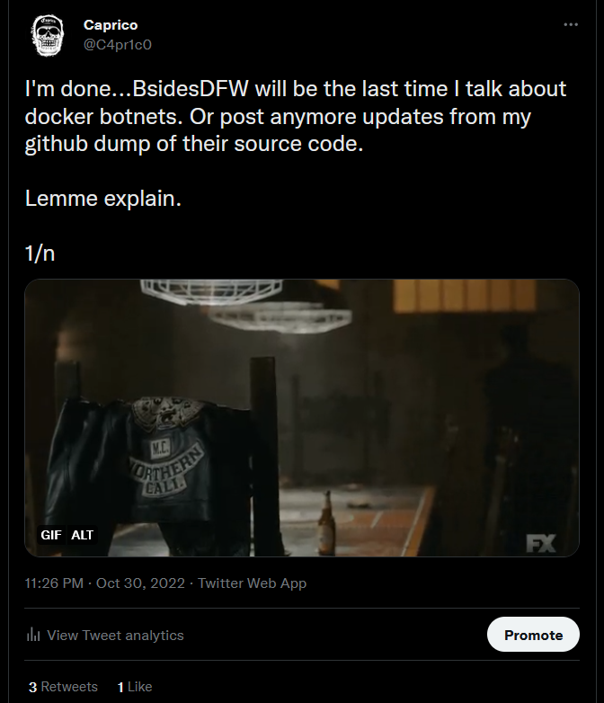
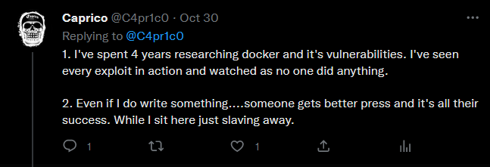
State of Crypto-Jacking Botnets

Slide 46
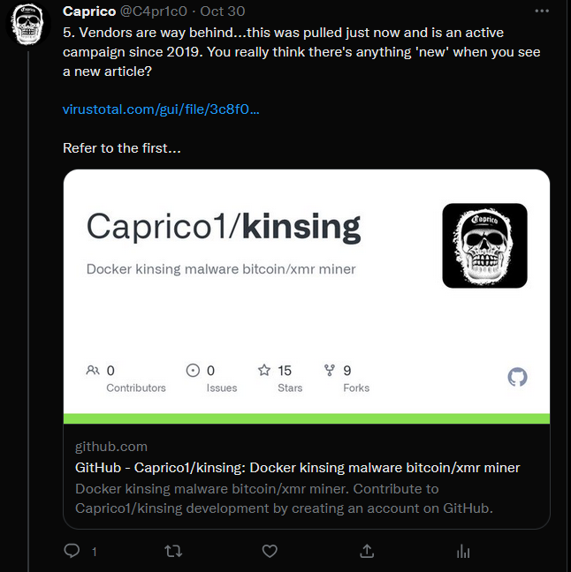
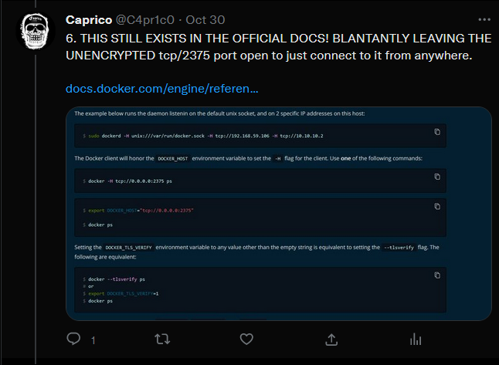
State of Crypto-Jacking Botnets

Slide 47
Conclusion
Should you use docker?
Yes, but tread carefully…there be dragons…
Crypto-jacking is not going anywhere and is a facilitator for future attacks.
Next steps:
Continued work in tracking these down.
This is the last time I’m doing this talk

Slide 48
Q&A TIME
@C4pr1c0 – on twitter… Feel free to DM me

Slide 49
Sources
https://blog.docker.com/2019/02/docker-security-update-cve-2018-5736-and-container-security-best-practices/
https://docs.docker.com/
https://www.youtube.com/watch?v=ib4lx9i6DLA&list=FLU7PgmLMYcRexHCU7rmnxmw&index=4&t=0s
https://www.datadoghq.com/docker-adoption/
https://docker.com/
https://capricocave.wordpress.com

